Slide 1



GPS ENABLED ONLINE ACADEMIC MONITORING SYSTEM
Team Hybertext Techies
Members |  | Mentors
Sri Hari Harran B Rathu N Stalin MK | Nivashini S Showentharya SK Swetha Jayashree S | Mr.K.R.Prasanna Kumar Assistant Professor / IT Mr.K.Logeswaran Assistant Professor / IT

Slide 2
PROBLEM STATEMMENT - KB185
To make learning a serious goal classroom transaction needs to be improved. To bring in paradigm shift, the teacher needs feedback, review and support.
In the existing system, there is no check for visit compliance. Visit reports are done on paper and half chance subjectivity. No data is available pertaining to visits for supporting the teacher to make data driven decision, for example training diagnosing the pedagogical issues, curriculum revision etc. In this context, we need the platform for automating the monitoring process.

Slide 3
PROBLEM STATEMMENT -KB185 (Cont…)
Requirements:
A mobile-based application needs to be developed which can be accessed on any mobile operating system like Android, Apple etc.
Application should be capable of capturing the GPS location of the user.
The app should have pre-defined questionnaire that should be used by the visiting officers for rating the quality of teaching.
A website should be developed to upload the visit reports.
A dash board based on the website should be provided to generate various reports based on the class room observation data."

Slide 4
Proposed Solution
The main goal is to develop a GPS enabled mobile based application to collect feedback.
Facility to collect feedback with photos
Design a website to access the reports based on the feedback.
User role based access to website and app
Email notification to users
Demo Link:
http://projectsit2020.000webhostapp.com/AP-AMS_Latest/
http://hypertexttechies2020.000webhostapp.com/SIH/AP-AMS/

Slide 5


Modules
The app / website facilitates with three type of Modules
Admin
(Head of Education Department)
Visit
(Visiting Officer)
Institution

Slide 6
DAY-WISE PROGRESS OF OUR PROJECT

Slide 7
DAY 1

Slide 8
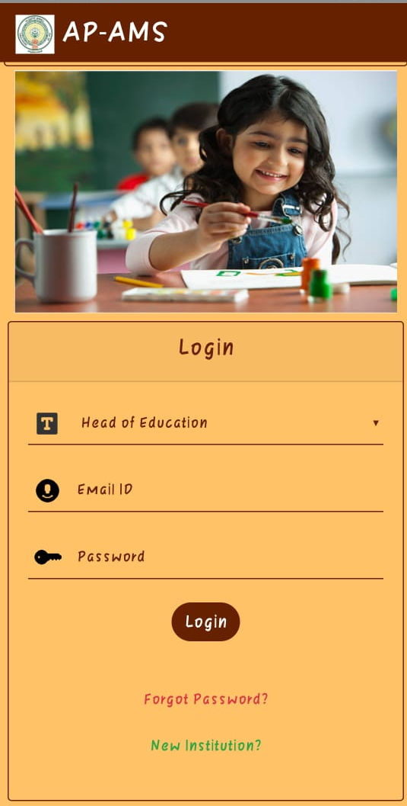
HOME PAGE:
Login for
Head of Education
Visiting Officers
Institution
Forgot password
New Institution

Slide 9
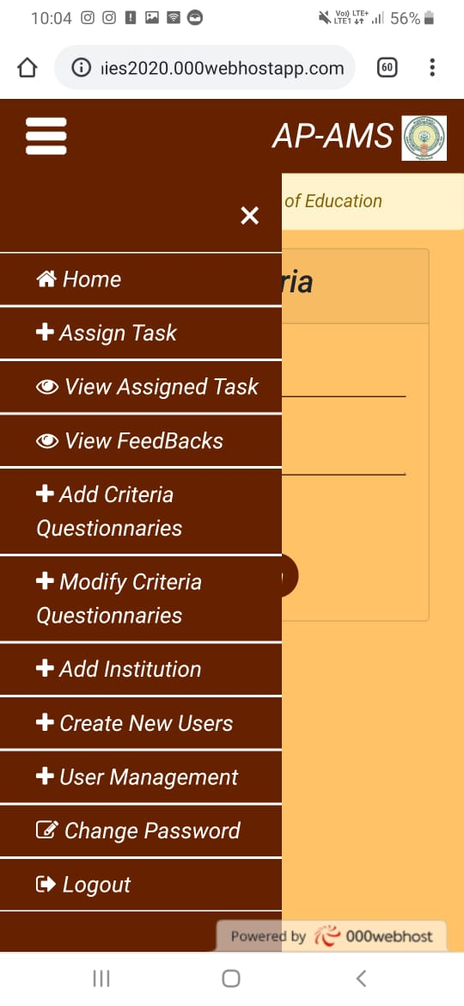
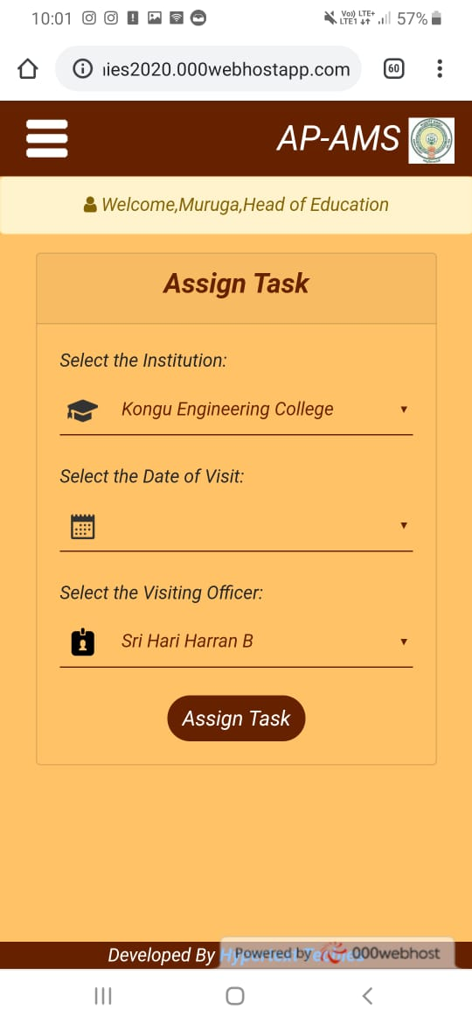
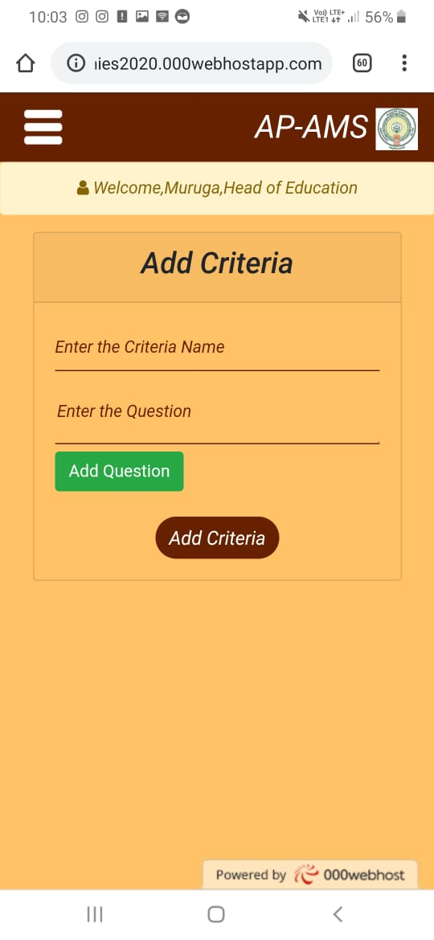
HEAD OF EDUCATION PAGE:
MENU:
ASSIGN TASK:
ADD CRITERIA:

Slide 10
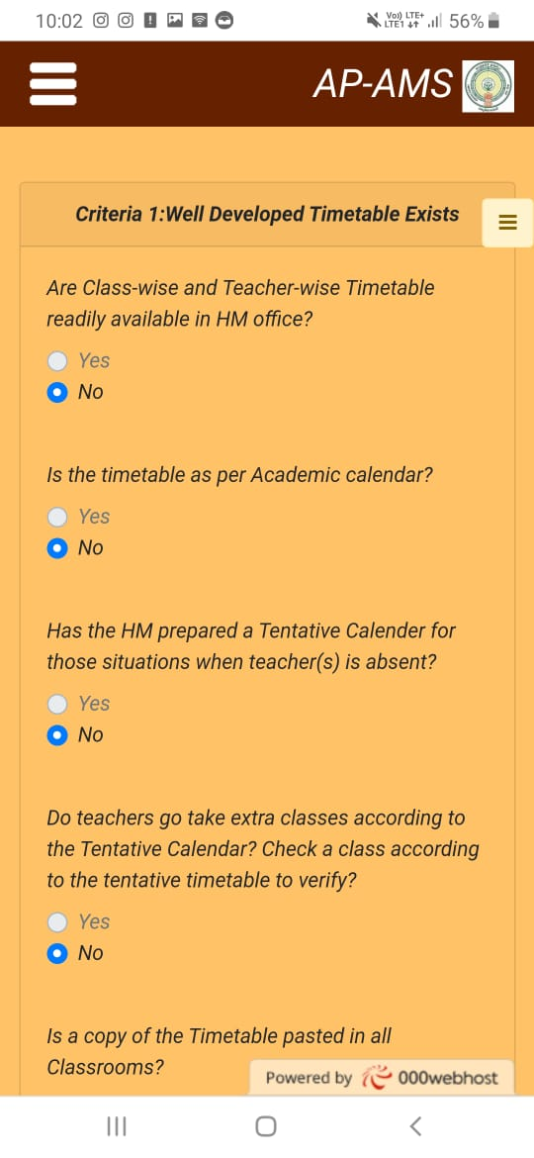
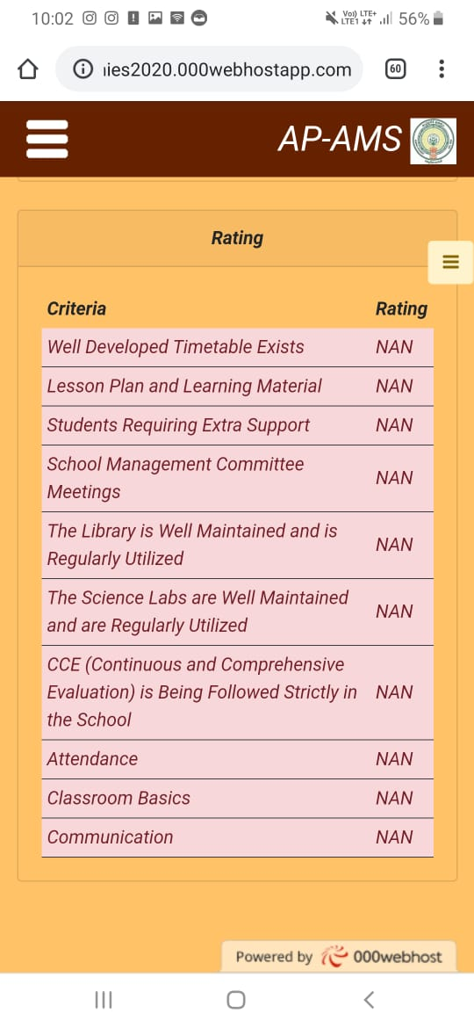
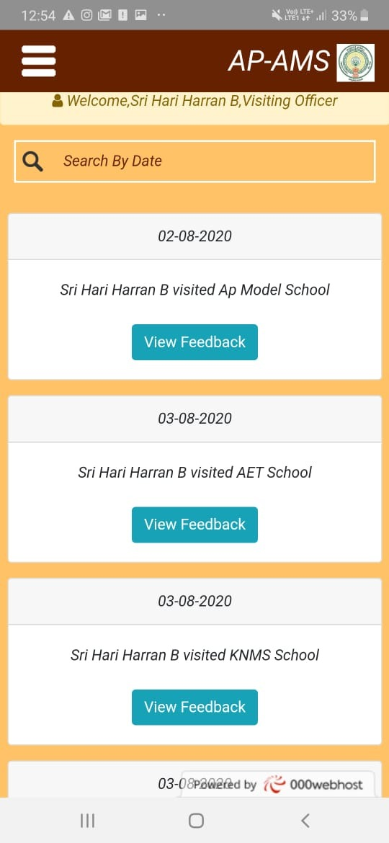
GIVE FEDBACK PAGE:
REPORT GENERATION PAGE:

Slide 11
DAY 2

Slide 12
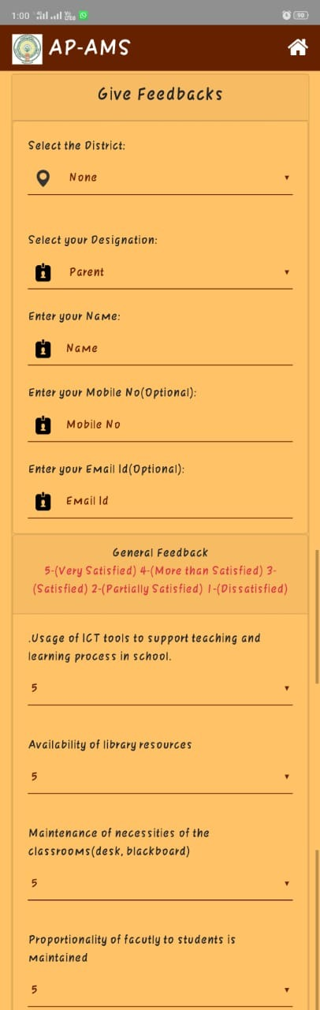
HOME PAGE:
Login for
Head of Education
Visiting Officers
Institution
Forgot password
New Institution
General Feedbacks

Slide 13
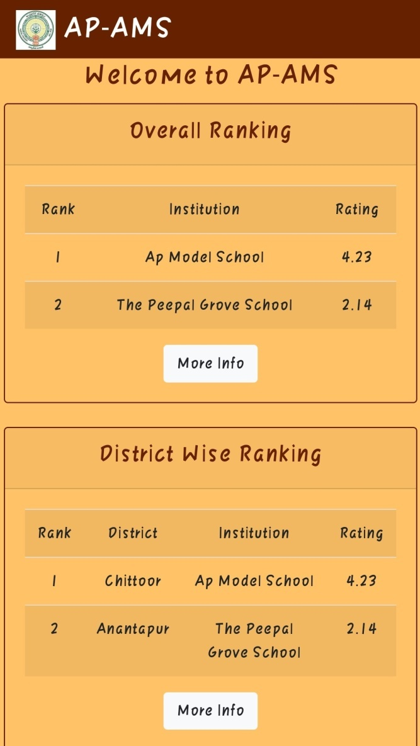
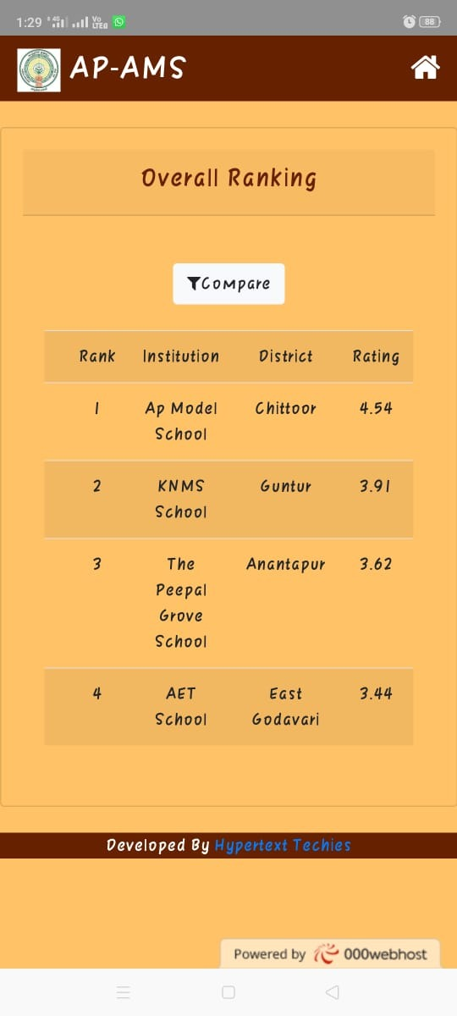
OVERALL &DISTRICT WISE RANKINGS:

Slide 14
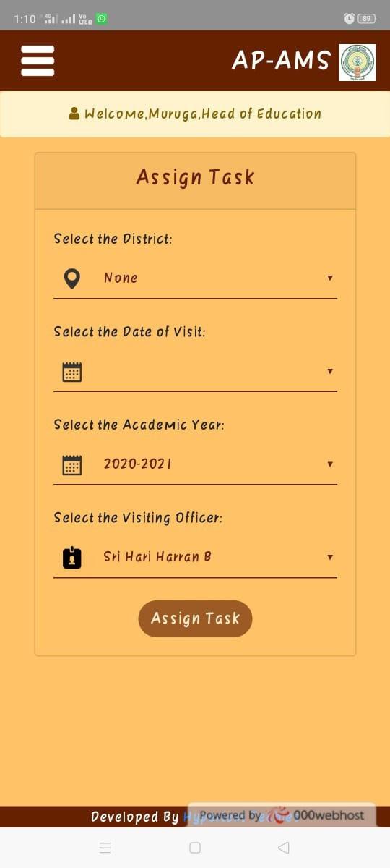
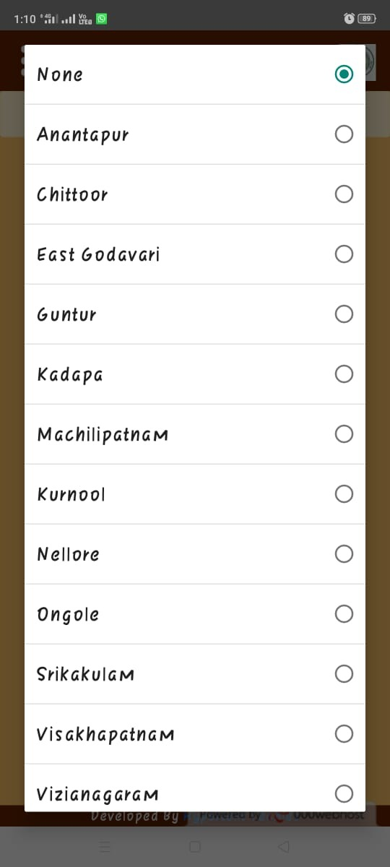
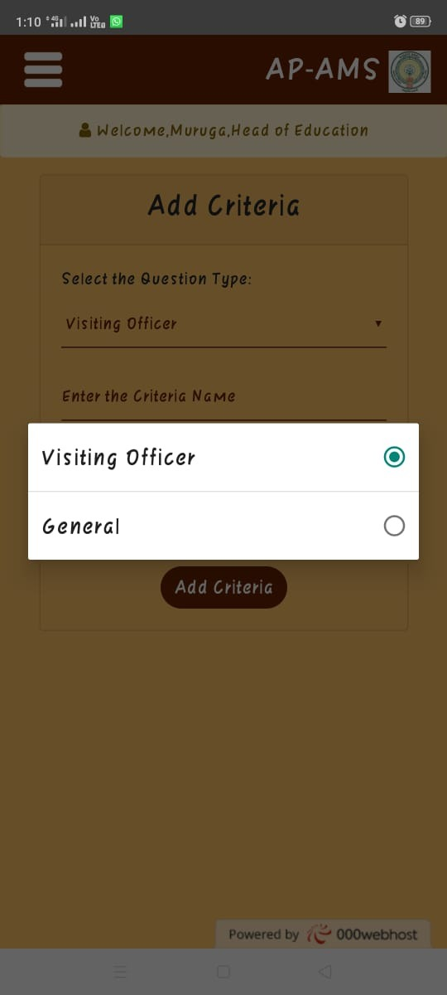
HEAD OF EDUCATION PAGE:
ASSIGN TASK:
District fields is added
ADD CRITERIA:

Slide 15
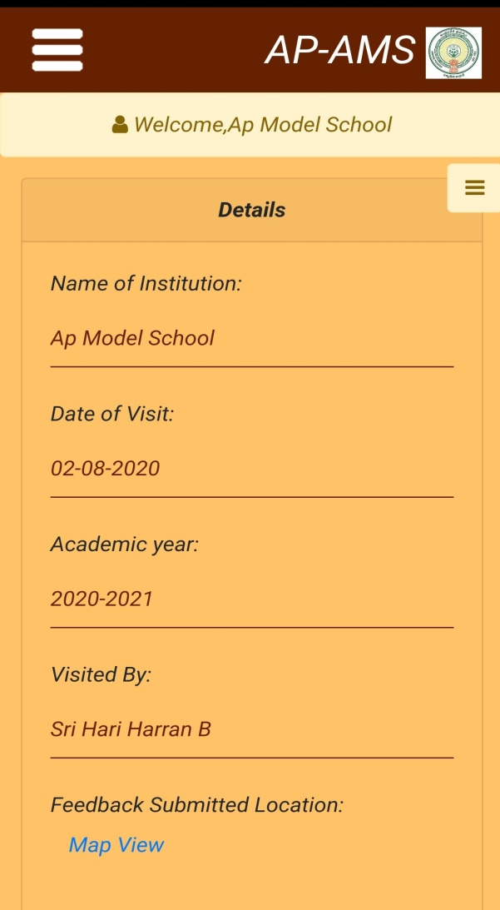
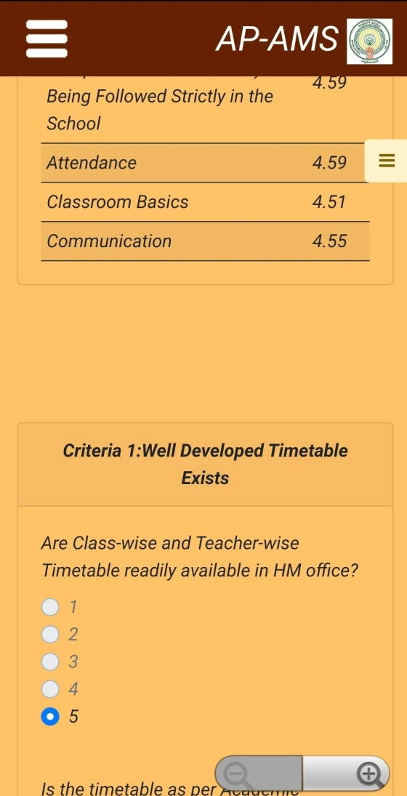
GIVE FEDBACK PAGE:
REPORT GENERATION PAGE:

Slide 16
DAY 3

Slide 17
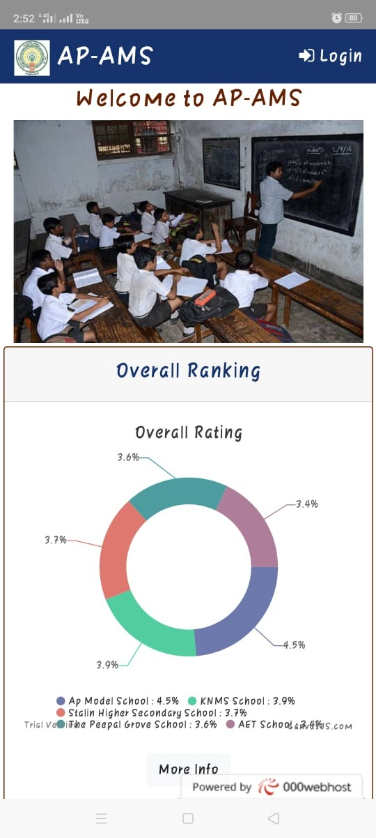
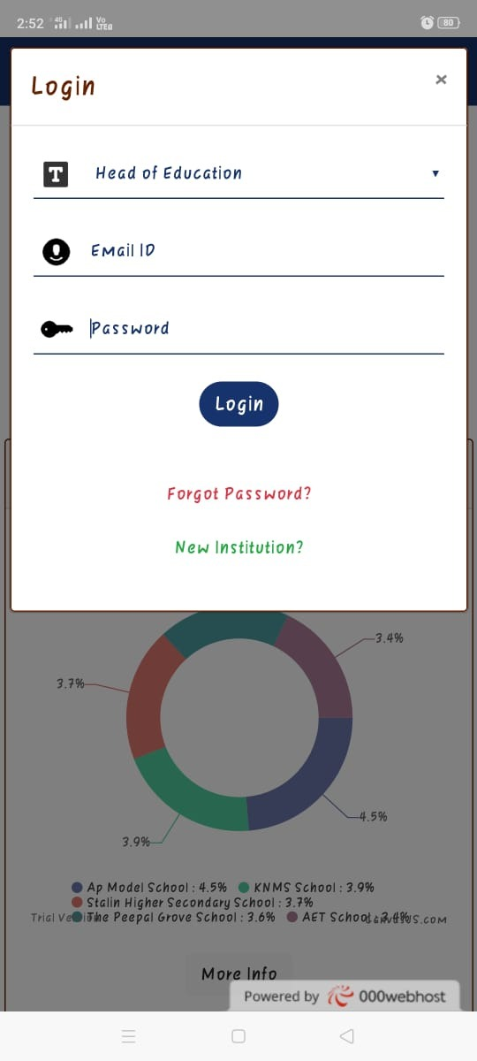
HOME PAGE:
Login for
Head of Education
Visiting Officers
Institution
Forgot password
New Institution
General Feedbacks
Feedback report via Graphs
Feedbacks from Alumini and Faculties
UI Updated

Slide 18
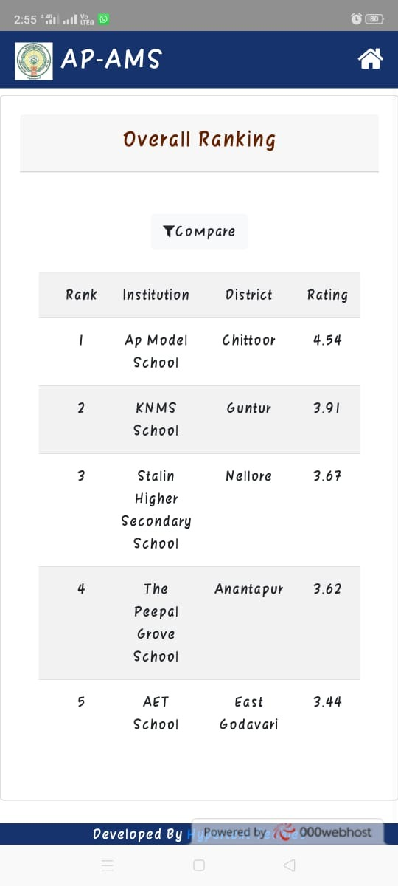
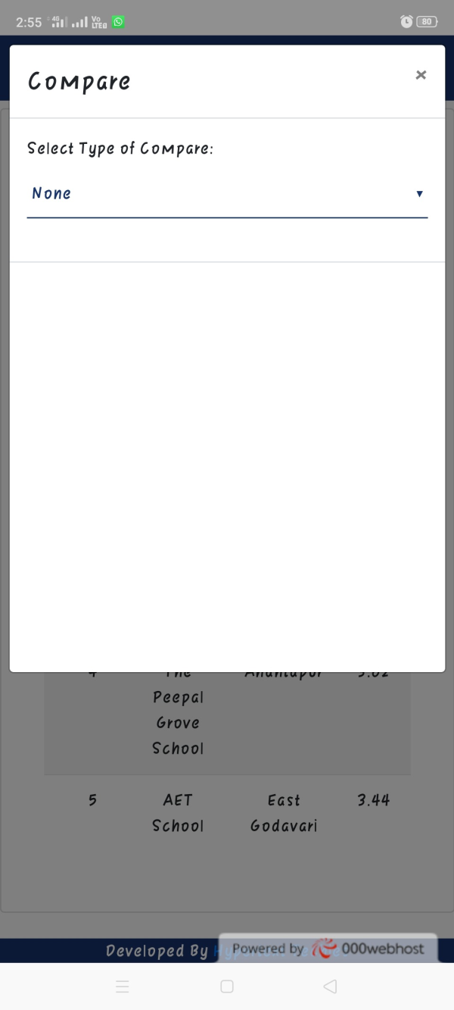
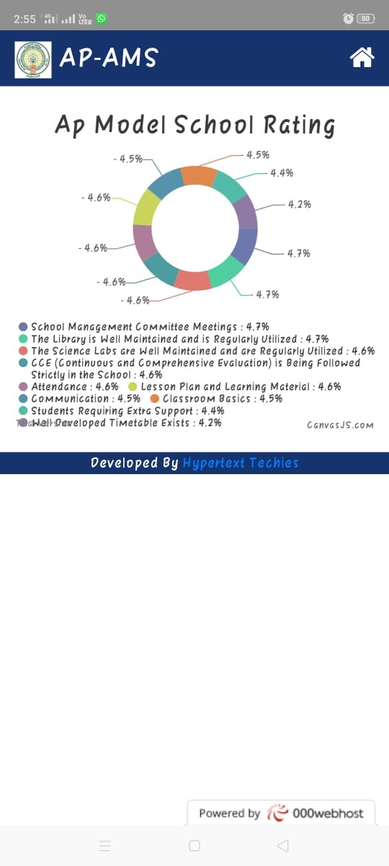
OVERALL RATING:

Slide 19
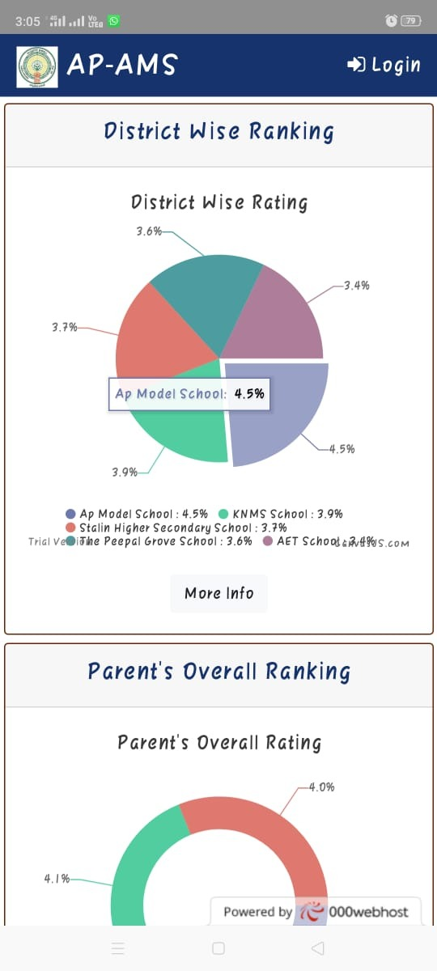
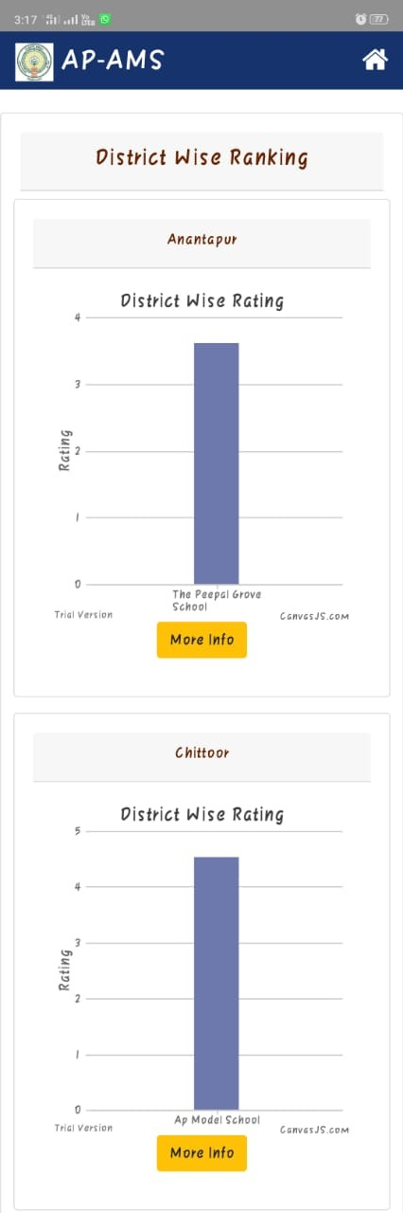
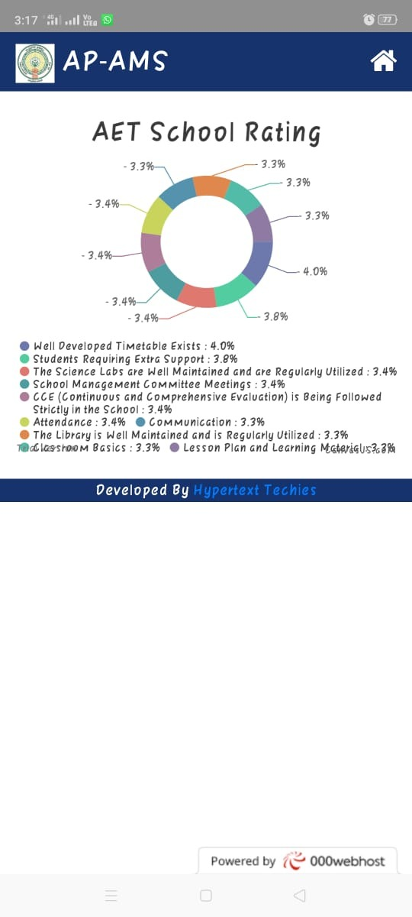
DISTRICT OVERALL RATING:

Slide 20
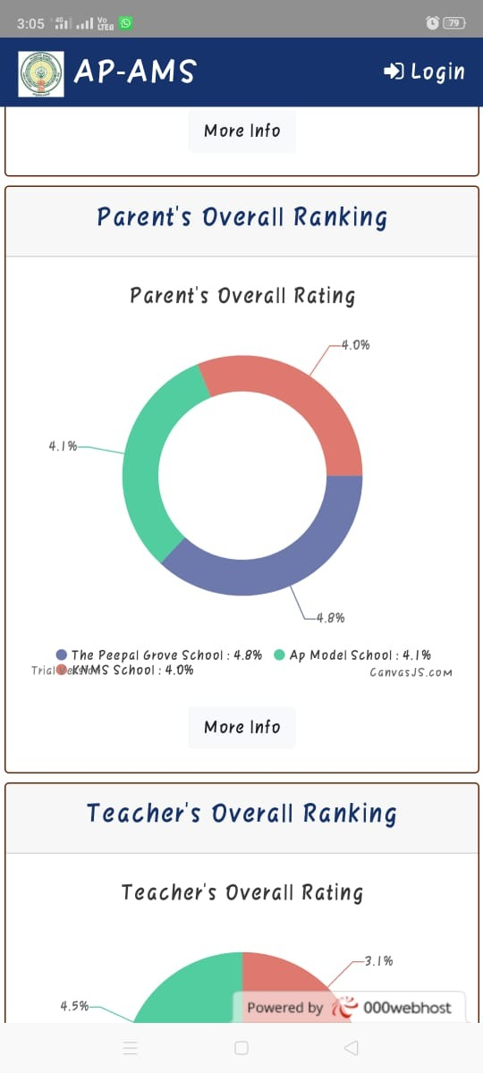
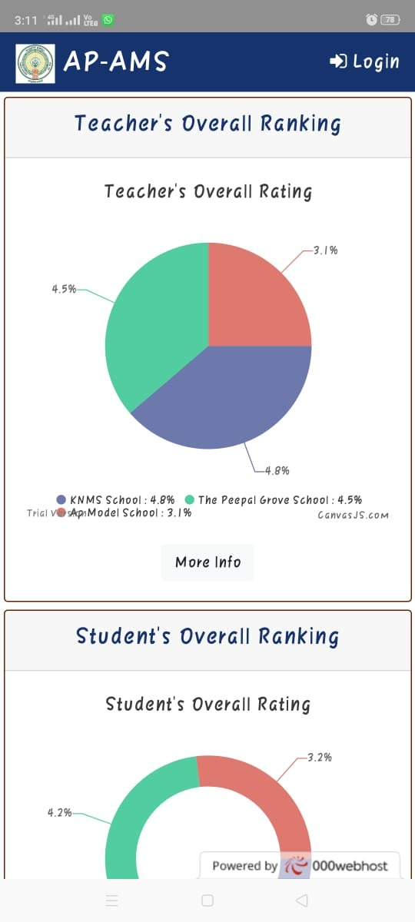
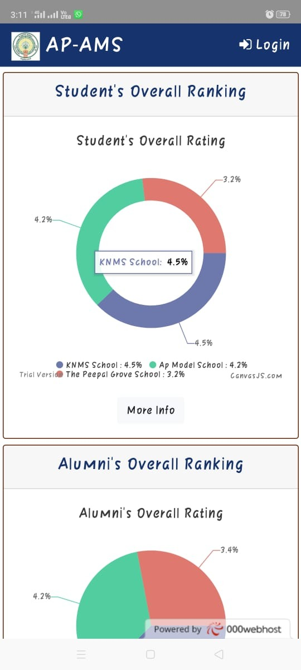
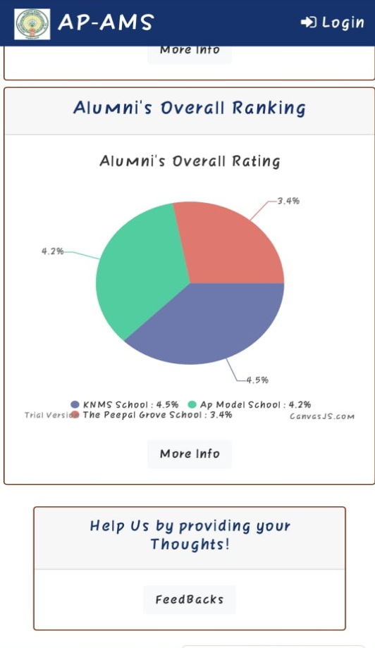
PARENTS,TEASCHERS ,STUDENTS AND ALUMINI OVERALL RATING:

Slide 21
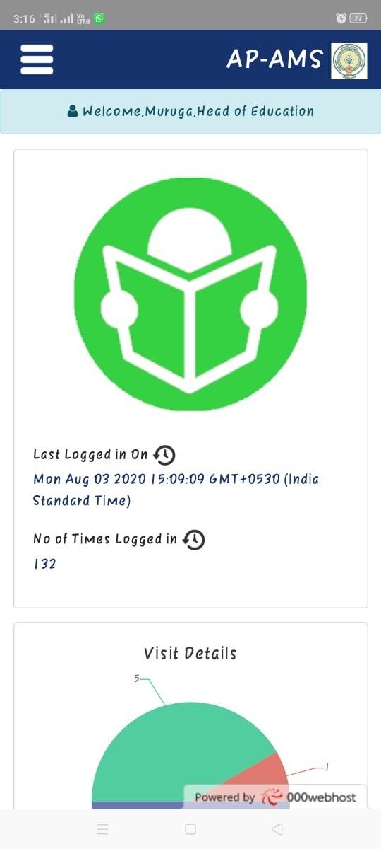
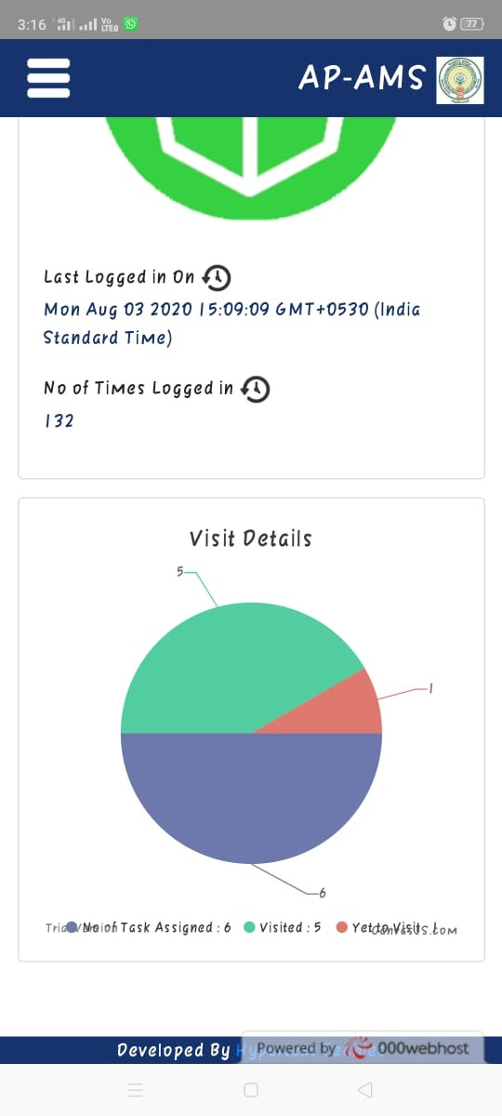
HEAD OF EDUCATION PAGE:

Slide 22
OVERALL GLIMPSE OF OUR PROJECT

Slide 23
HEAD OF EDUCATION

Slide 24
DISTRICT OVERALL RATING:

Slide 25
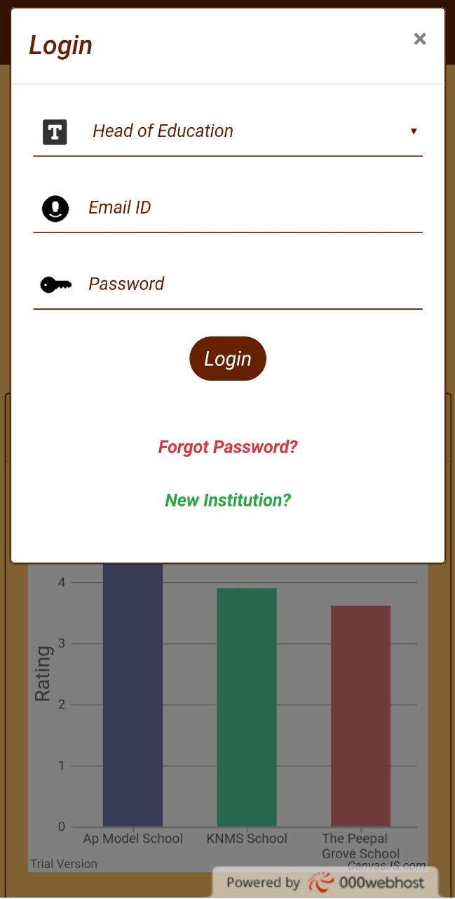
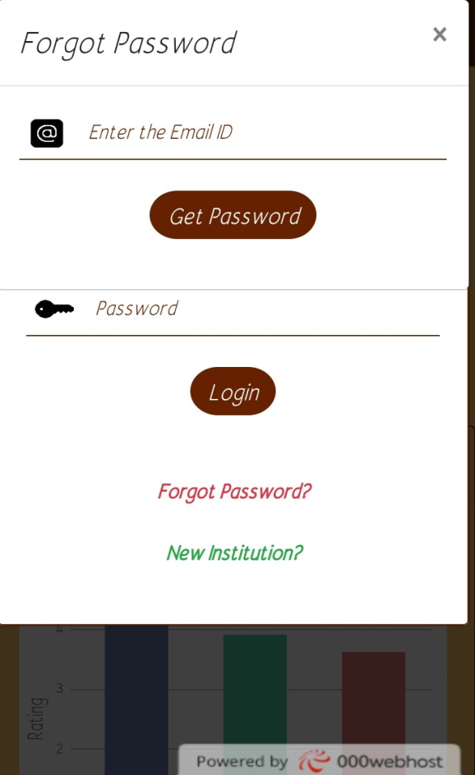
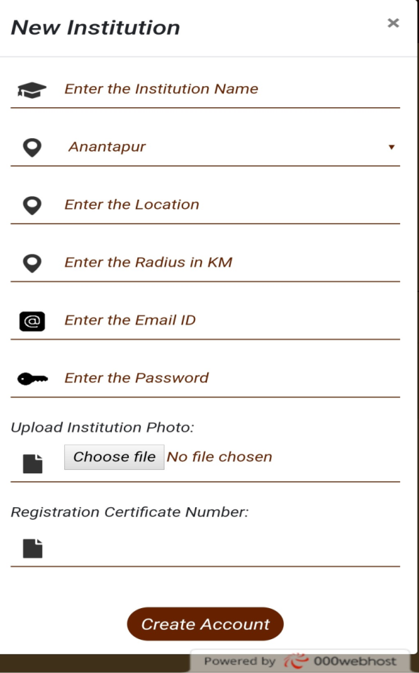
LOGIN PAGE
LOGIN
FORGOT PASSWORD
NEW INSTITUTION- new institution registration

Slide 26
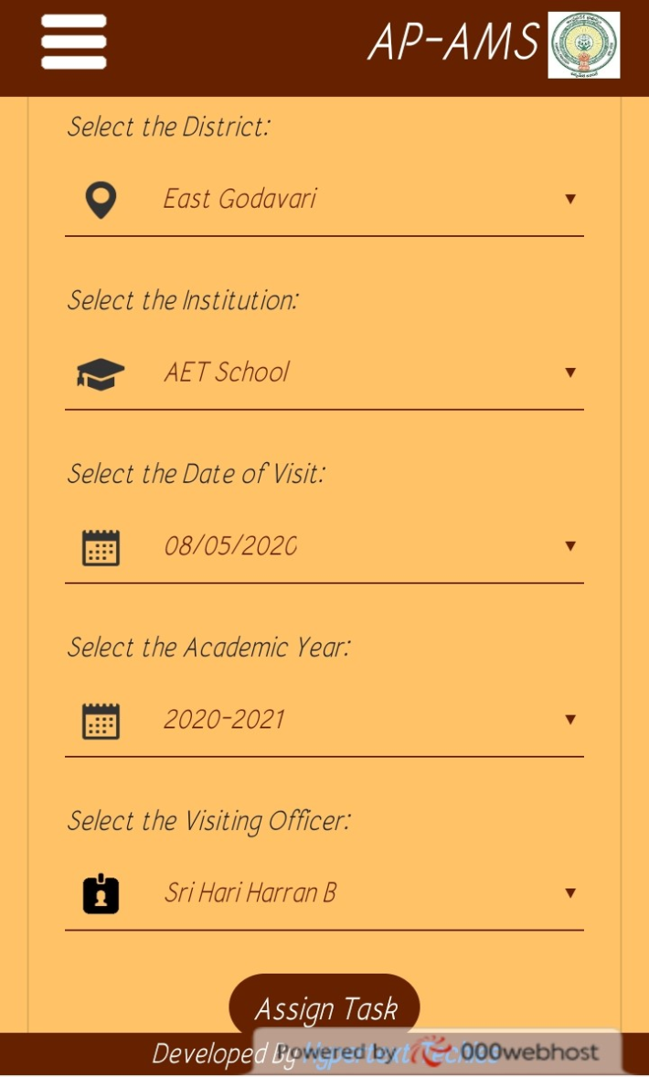
HEAD OF EDUCATION
ASSIGN TASK - Tasks are assigned by the admin

Slide 27
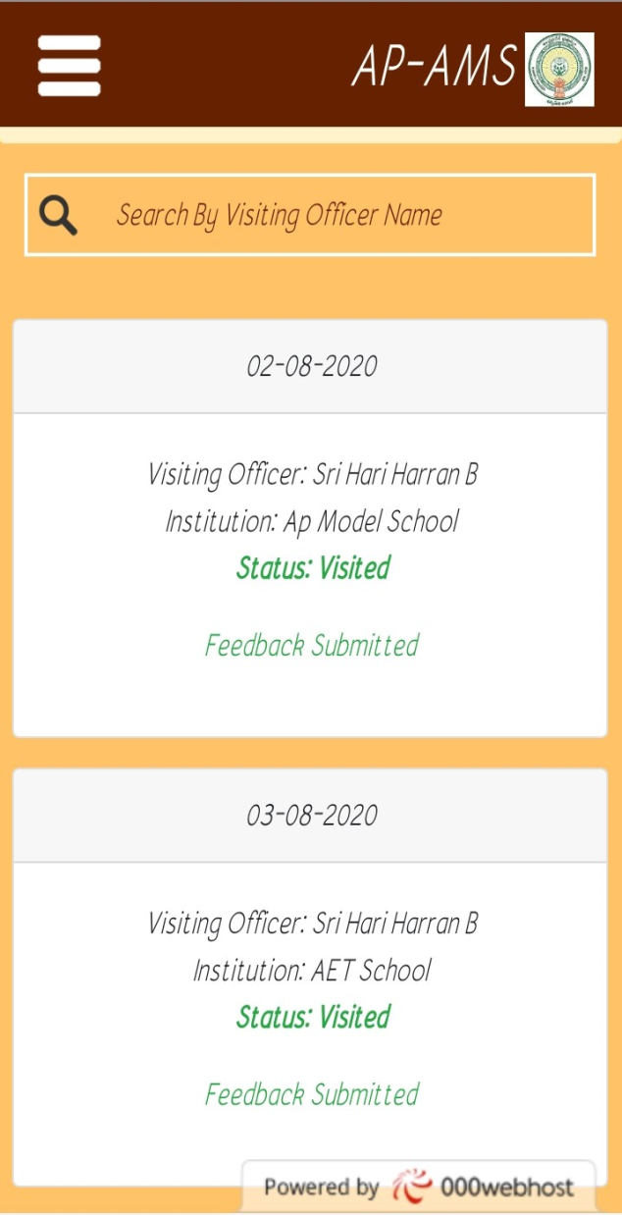
HEAD OF EDUCATION
VIEW ASSIGNED TASK- Status of the task assigned by admin will be displayed here

Slide 28
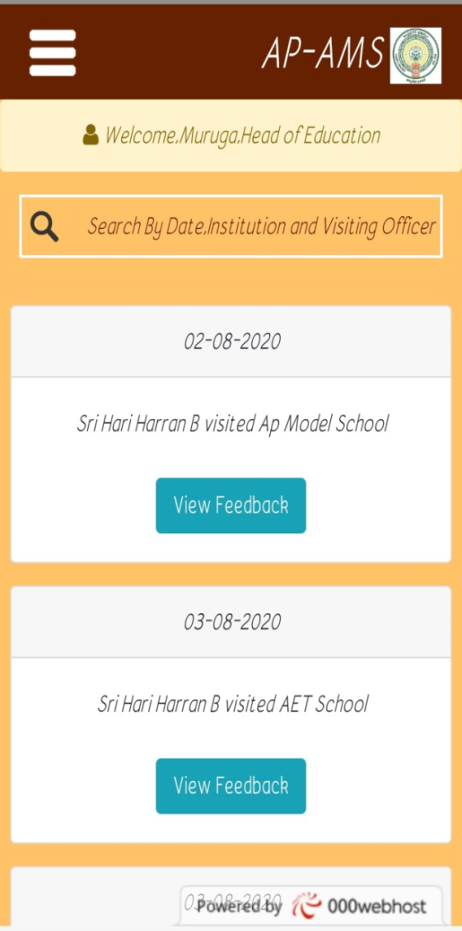
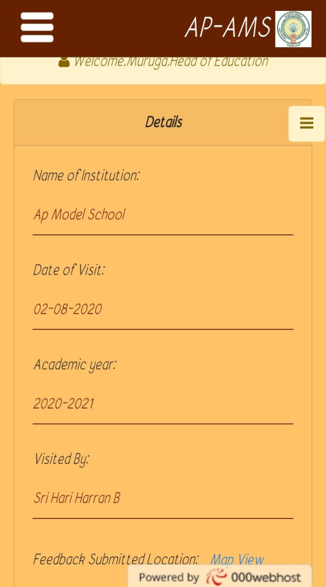
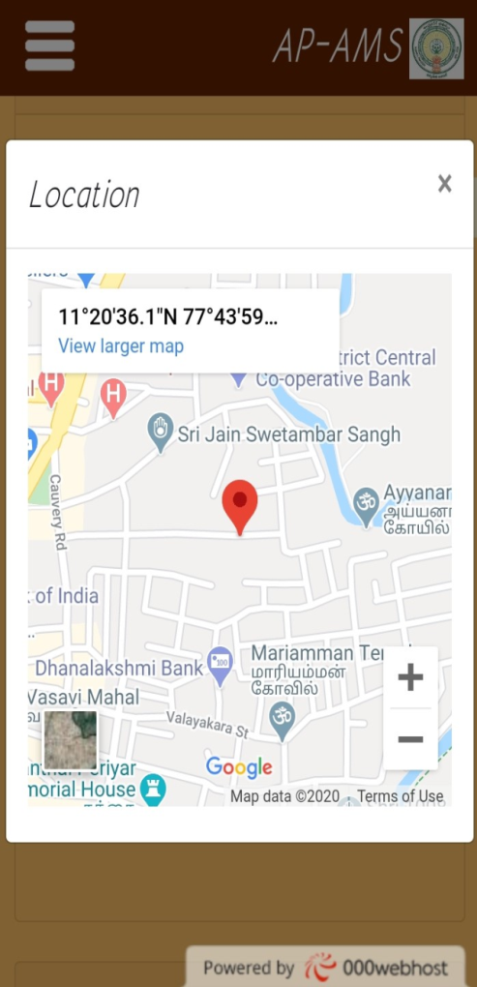
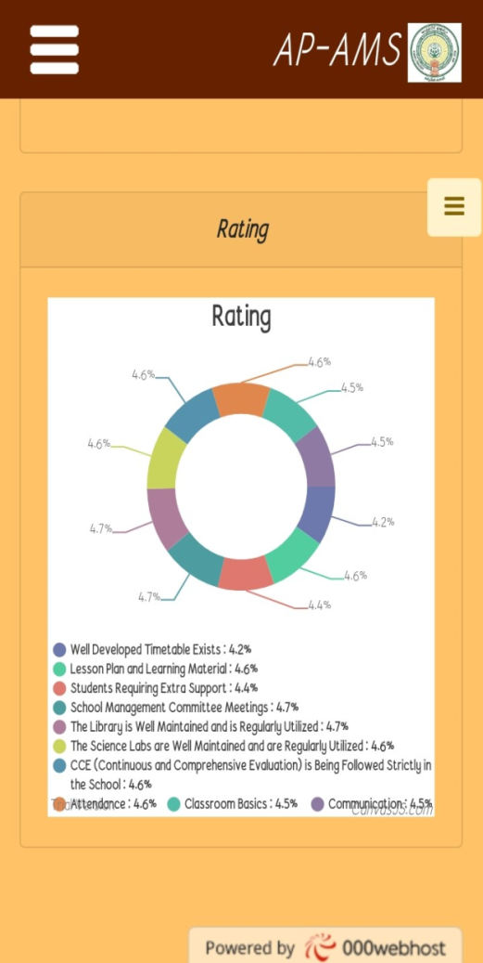
HEAD OF EDUCATION
VIEW FEEDBACKS- The admin can view the Feedbacks and Rating

Slide 29
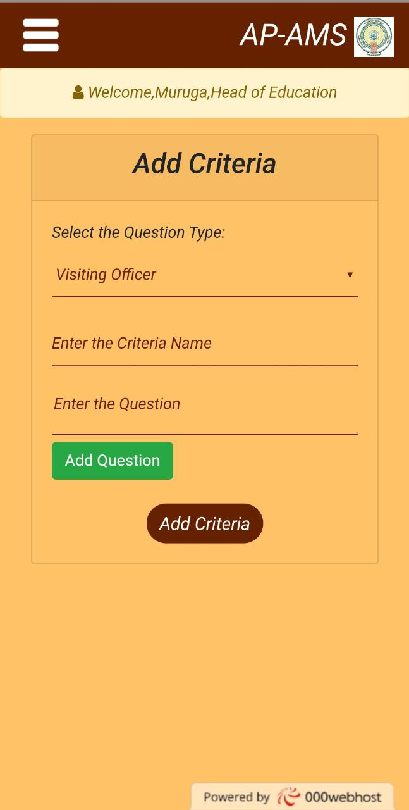
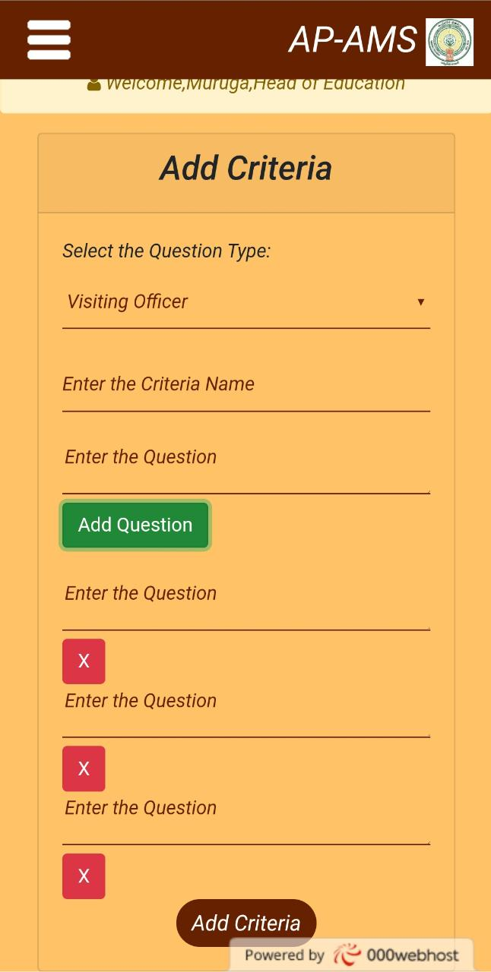
HEAD OF EDUCATION
Add Criteria: Criterias can be added if needed.

Slide 30

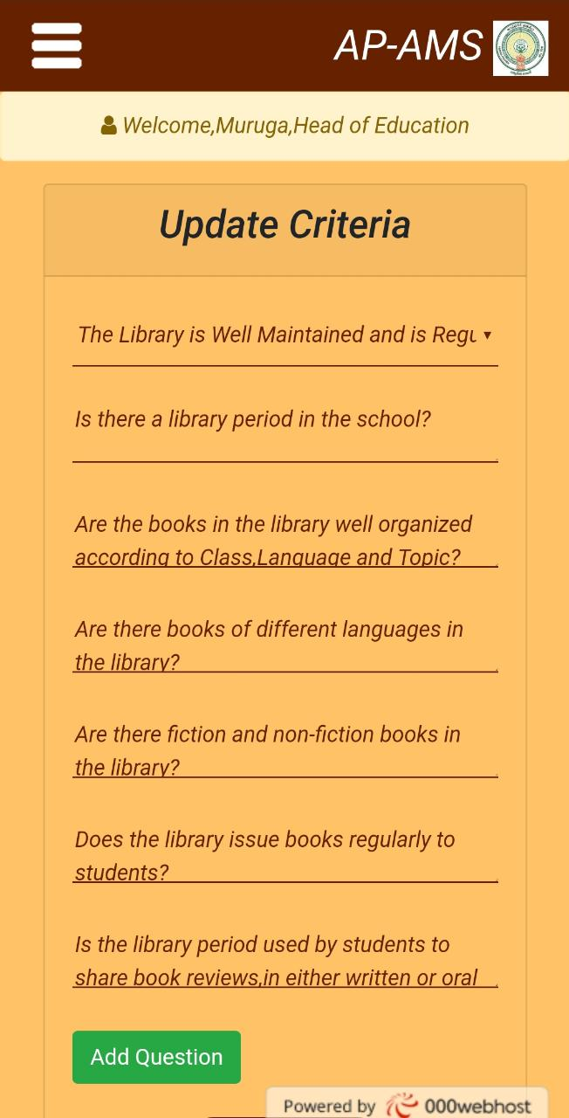
HEAD OF EDUCATION
Modify Criteria: Criterias can be modified if needed.

Slide 31
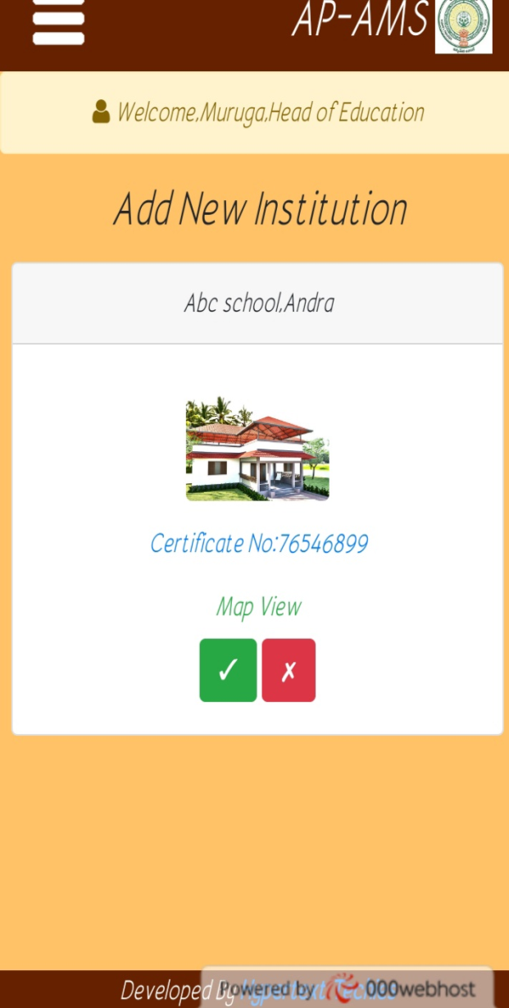
HEAD OF EDUCATION
ADD NEW INSTITUTION- Verification of new institution is done.

Slide 32
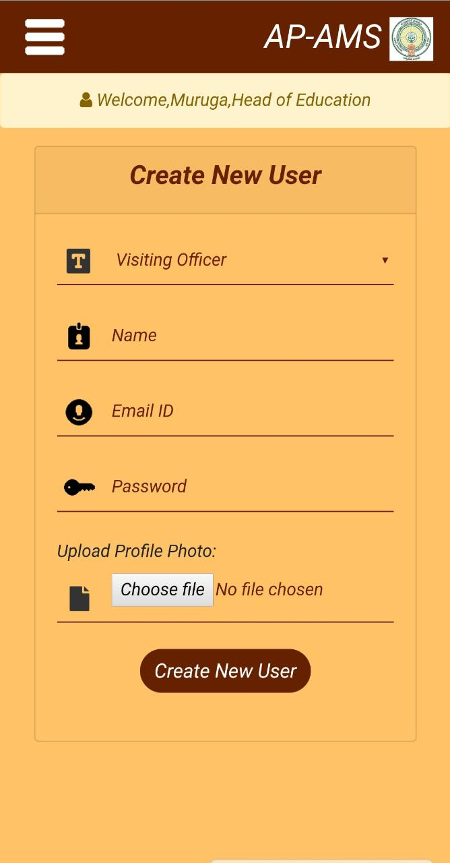
HEAD OF EDUCATION
Create New User: New users can be created.

Slide 33
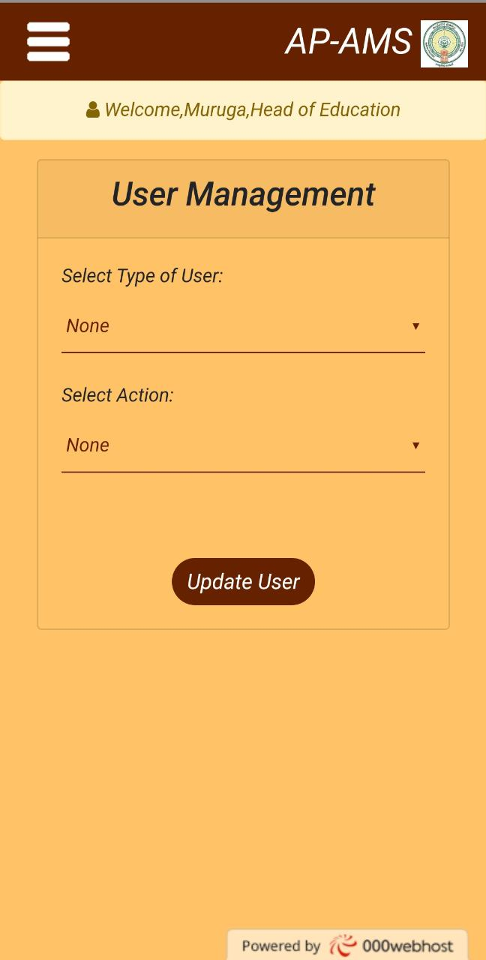
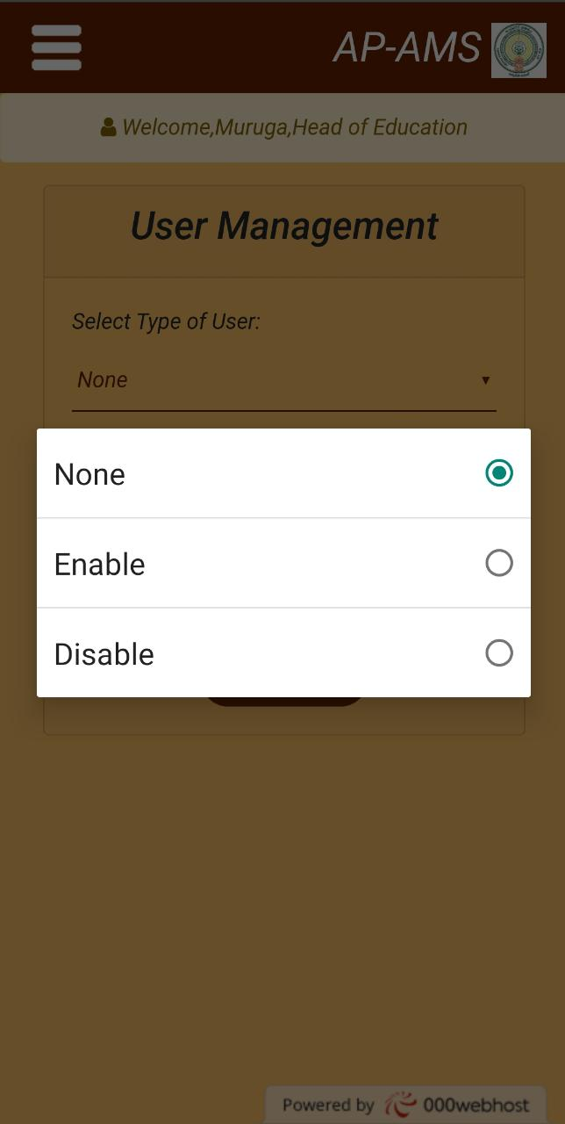
HEAD OF EDUCATION
User Management: User login can either be enabled or disabled by Head Of Education.

Slide 34
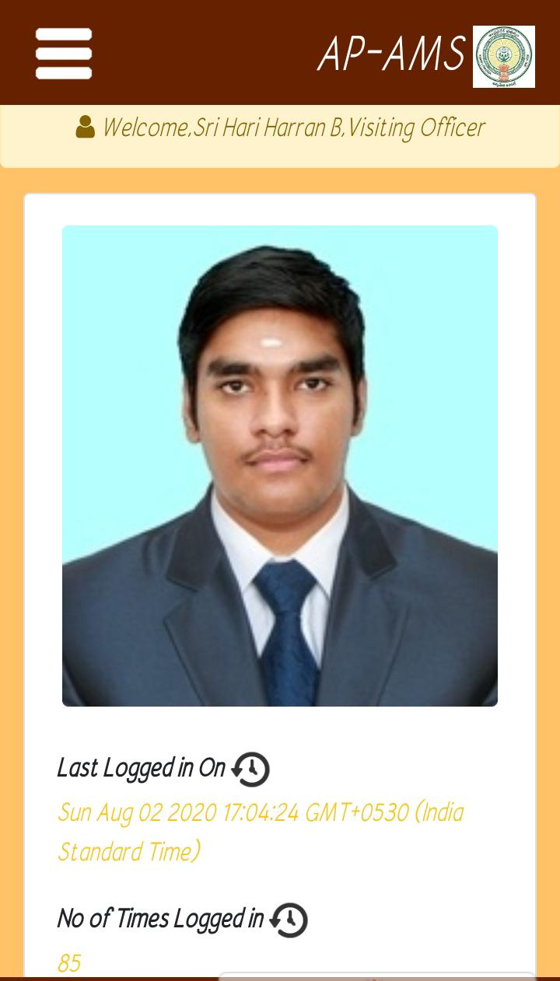
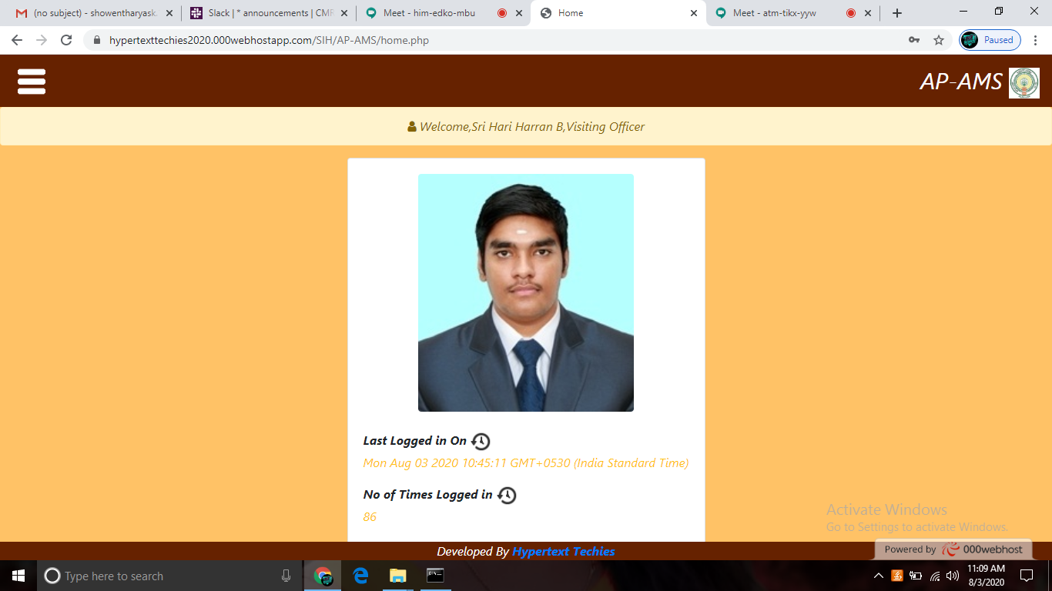
VISITING OFFICER
HOME PAGE: Last logged in time and number of times logged in available
Phone View Web View

Slide 35
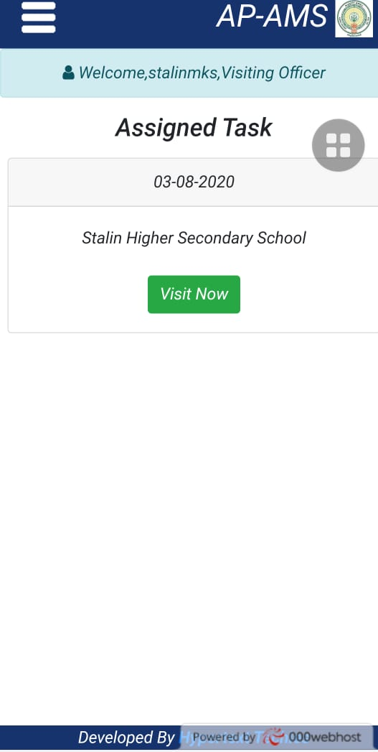
VISITING OFFICER
View Assigned Task: Status of inspection available

Slide 36
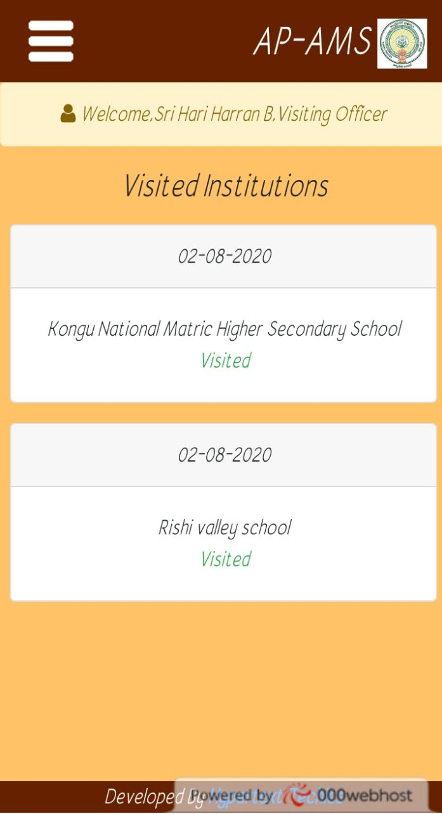
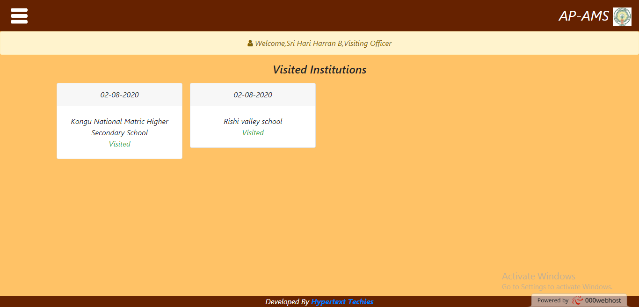
VISITING OFFICER
Visited Instititions: Number of institutions visited and its details available
Phone View

Slide 37




VISITING OFFICER
View Feedbacks: Feedbacks include map view location and rating
List of feedbacks Feedback Details Map View Ratings

Slide 38


INSTITUTION
HOME PAGE:
Phone View Web View

Slide 39

INSTITUTION
View Visitor Details:

Slide 40



INSTITUTION
View Feedbacks: Feedbacks given by Visiting Officers are available.

Slide 41



INSTITUTION
General Feedbacks: Feedbacks given by General Public are available.

Slide 42


PROVISION FOR ALL THE THREE LOGINS:
Change Password:
Phone View Web View

Slide 43
VISITING OFFICER
HOME PAGE: Last logged in time and number of times logged in available
Phone View Web View

Slide 44
INSTITUTION
HOME PAGE:
Phone View Web View

